Slide 1
WIFI
PalmH / TicketBreedProfession

Slide 2
Lecture One
Course Overview &
Intro to Space

Slide 3
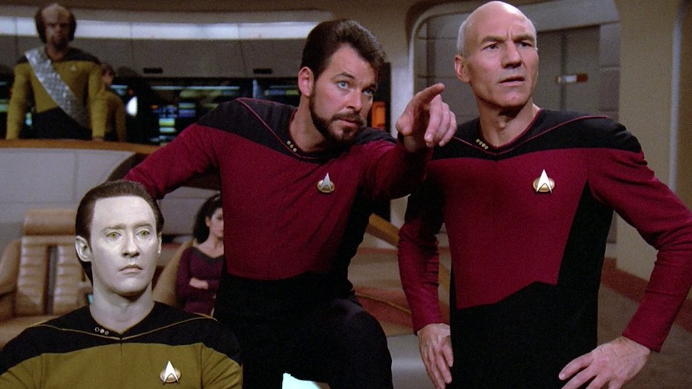
Meet the instructors!

Slide 4








Jacob Oakley

Slide 5


Michael Butler

Slide 6






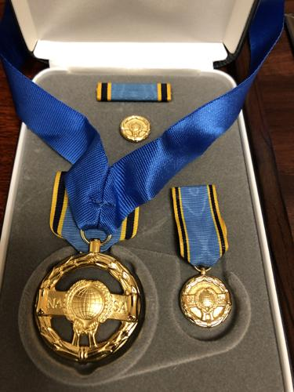

Current Job: Principal Engineer, Cybersecurity and Advanced Platforms Subdivision (CAPS), at The Aerospace Corporation
Developing cyber labs for training, perform penetration testing & vulnerability assessments {Ethical Hacking!}
Performing cybersecurity research on ground systems and spacecraft systems to better position the federal government with respect to protection of our critical space infrastructure.
Brandon Bailey
B.S. Electrical Engineering West Virginia University
Lockheed Martin Supporting National Geospatial Intelligence Agency
Transitioned to NASA Government Employee GS-13
Began “Hacking” Space Systems
Left Job as CTO to join Aerospace Corporation Federally Funded and Development Center
2024
2009
2018
2005
2013
2019
DefCON Presentations:
DEF CON 2020: Exploiting Spacecraft
DEF CON 2021: Unboxing the Spacecraft Software BlackBox Hunting for Vulnerabilities
DEF CON 2022: Hunting for Spacecraft Zero Days using Digital Twins
DEF CON 2023: Building Space Attack Chains using SPARTA
Papers/Articles:
2019: Defending Spacecraft in the Cyber Domain
2020: Establishing Space Cybersecurity Policy, Standards, & Risk Management Practices
2021: Cybersecurity Protections for Spacecraft: A Threat Based Approach
2021: Translating Space Cybersecurity Policy into Actionable Guidance for Space Vehicles
2022: Protecting Space Systems from Cyber Attack
2024: Space Segment Cybersecurity Profile for NSS
July 2022 Congressional Testimony:
Video: https://science.house.gov/hearings?ID=996438A6-A93E-4469-8618-C1B59BC5A964
Written Testimony: https://republicans-science.house.gov/_cache/files/2/9/29fff6d3-0176-48bd-9c04-00390b826aed/A8F54300A11D55BEA5AF2CE305C015BA.2022-07-28-bailey-testimony.pdf
SPARTA Launched
https://sparta.aerospace.org
NASA’s Independent Verification and Validation Program
Working for Small Business in West Virginia doing Spacecraft and Ground Simulation/Emulation
Left the Government as GS-15 to become
Chief Technology Officer (CTO) for small business in West Virginia
- Supported NASA part-time as contractor
2019-2024
Pen-tested / “Ethically Hacked” Space Systems
Mars' Rovers (MER & MSL) & Deep Space Network (DSN) at JPL
Hubble Space Telescope (HST) at GSFC
Closed IONet (CIONet) within NASCOM at GSFC
Space Network (SN) at the White Sands Complex (WSC)
KSC Ground Systems Development and Operations (GSDO) Kennedy Ground Control
System (KGCS) and Launch Control System (LCS)
James Web Space Telescope (JWST) Ground System at the Space Telescope Science Institute (STScl) in Baltimore
Huntsville Operations Support Center (HOSC) at Marshall Space Flight Center
Near Earth Network (NEN) at Wallops Flight Facility
ISS Mission Control Center (MCC) at Johnson Space Center
Wind tunnels at Glenn Research Center
Hypersonic Environment at Langley Research Center
NOAA's Joint Polar Satellite System (JPSS)
2013-2024
NASA’s Exceptional Service Medal (2019) for “groundbreaking” cyber work

Slide 7
Class Day 1
0900 – 1000 Lecture 1: Lecture 1: 60m Intro to course & Understanding the attack surface
1000 – 1030 Lab 1: 30m NOS3 and ground control system operations
1030 - Break: 15m
1045 – 1130 Lab 1: 45m NOS3 and ground control system operations continued
1130-1230 Lecture 2: 60m Adversarial Perspective
1230-1345 Lunch
1400-1500 – Lab 2: 1hr insider threat, malicious tasks
1500 - 1600 – Lab 3: 1hr Exploiting ground to space without using ground SW (garak command sender)
1600-1615 Coffee Break
1615 – 1700 Lab 4: 45m IOCs and cleaning up after yourself
1700 – 1800 FFA

Slide 8

Space

Slide 9

Purpose
Space Systems have unique constraints, challenges, technologies, missions and CONOPS
These aspects dictate adversary tradecraft
Understanding how malicious actors will operate within these systems is key to figuring out how to stop them

Slide 10
So What?
Very limited international communication
No weather forecasting
No PNT
Flights grounded, ships lost at sea, inability for most people to navigate
No time
Encryption
Financial transactions
Network protocol failures
A bit hyperbolic, but illustrative of how important space has become

Slide 11
Key Terms & Definitions
SDR: Software defined radio capable of reprogramming RF communications characteristics
Modem: modulates and demodulates RF signals
Telemetry (TLM): Data from a spacecraft is telemetry, engineering (housekeeping) or science data
Command / Task: request made to the satellite or payload to do or report something
ADCS: Attitude determination and control system turns commands into execution
Flight software: suite of SW and framework running on the flight computer (ADCS + comms, data management, storage etc)
Satellite Bus: components responsible for flight
Payload: components responsible for mission
Software Bus: pub-sub mechanism for flight computer and ADCS to communicate to things like propulsion, PNT receiver, star tracker, sun sensor, solar panels battery etc.

Slide 13
Notes:
Space systems are really systems of systems…….of systems

Slide 15
Detailed Diagram
Notes:
Walk through how ground to space comms are more familiar to security folks then they might think

Slide 16
Detailed Diagram
Notes:
Red shows whats firmly within the space domain; subject to EW

Slide 17
Detailed Diagram
Notes:
Red shows whats considered the physical layer and not necessarily the cyber domain

Slide 18
Detailed Diagram
Notes:
Red shows whats considered the cyber domain

Slide 19
Notes:
Talk about how LEO and stuff that moves brings its own set of issues (short passes etc)

Slide 20
Ground Station Functions
Antennae movement
Communication
Tasking
Flight
Payload
Dissemination

Slide 21
Space Vehicle Functions
Bus
Power
Generate, Store, Moderate
PNT
GPS, Star Tracker, Sun Sensor
Flight:
Propulsion & Attitude adjustment
Communication
Payload
Tasking
Data storage and off load

Slide 22
Environmental Challenges
Radiation
Single events
Accumulation
Temperature extremes
Vacuum
Space objects
Junk
Others
Vibration

Slide 23
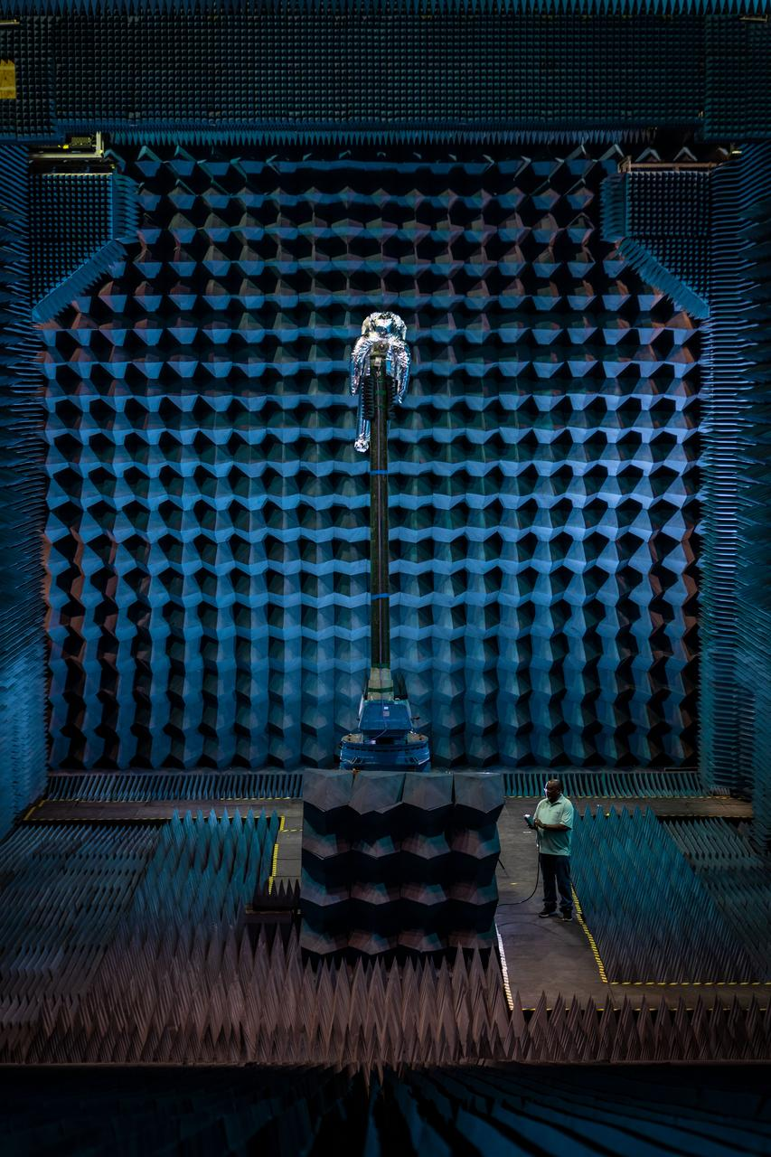
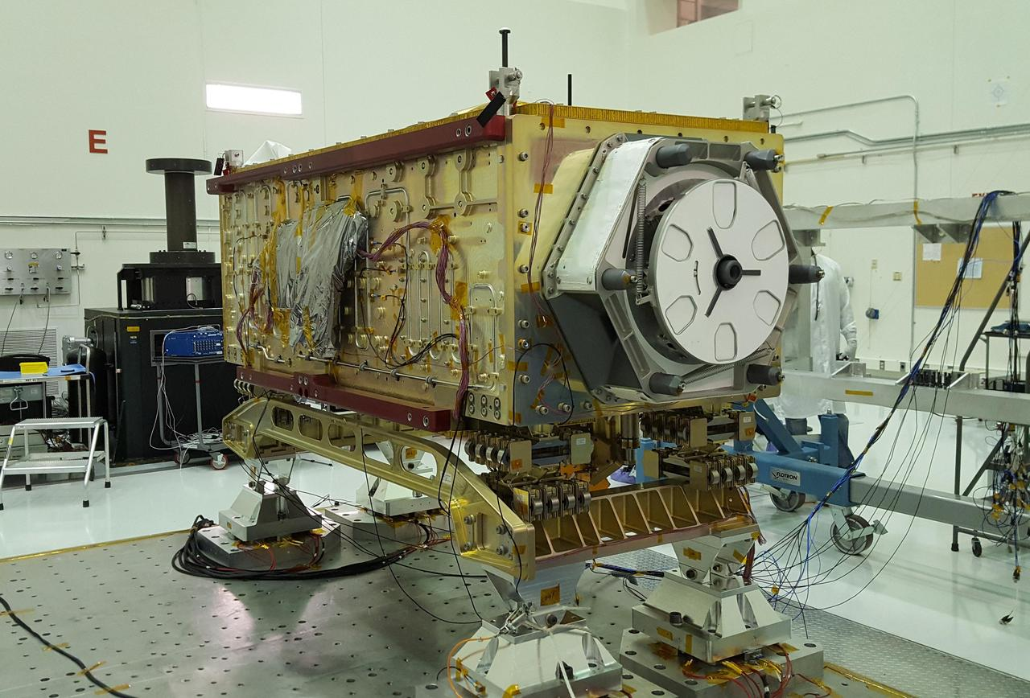
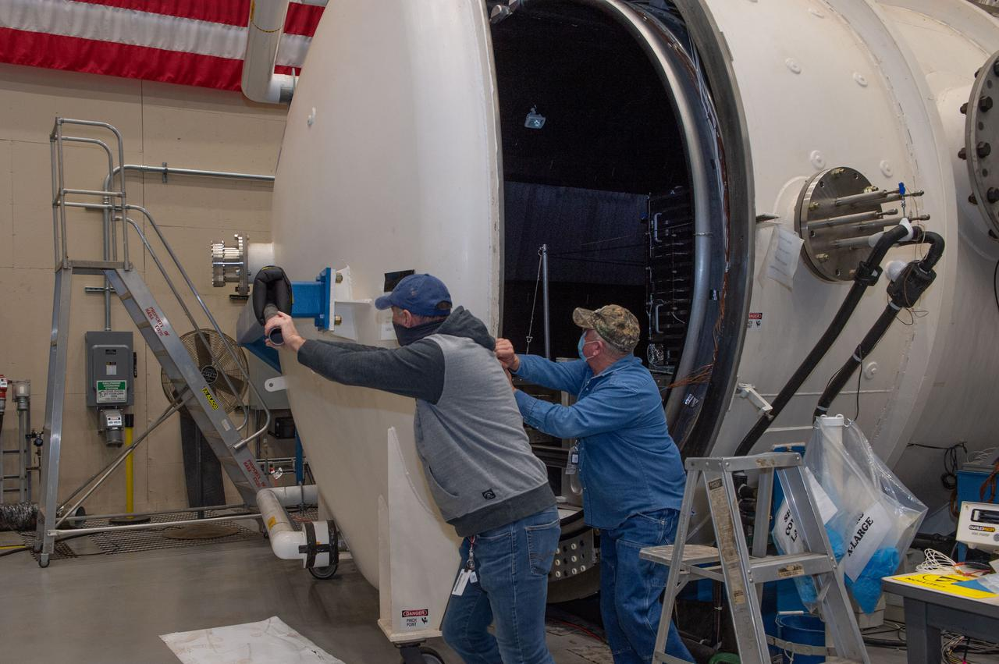
Operational Challenges
Testing

Slide 24
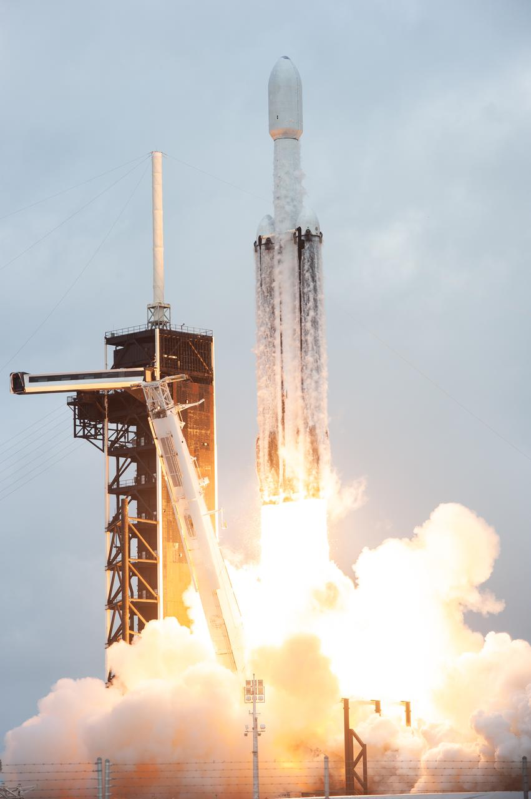
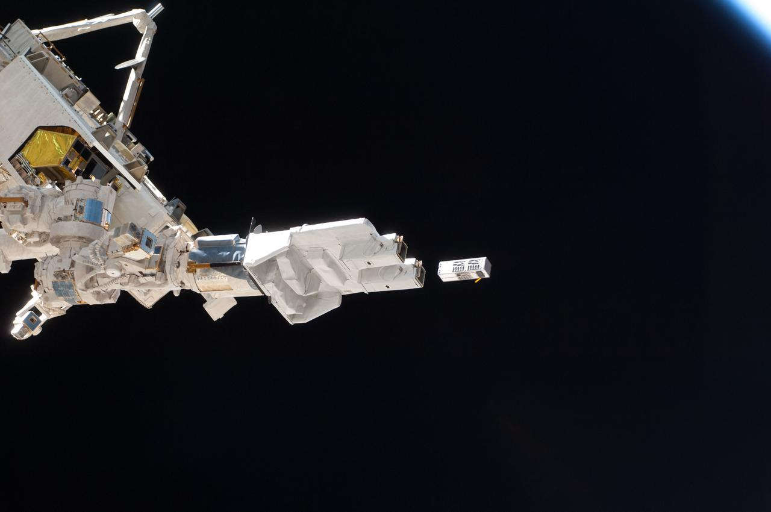
Operational Challenges
Launch
Deployment
Stabilization
De-tumble
Orbit

Slide 25
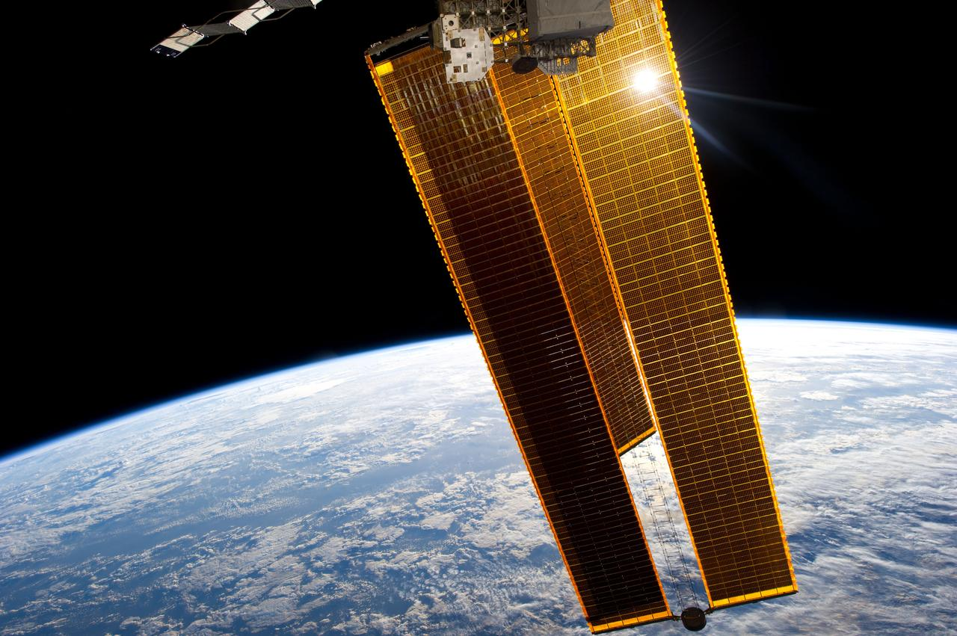
Operational Challenges
Power
Emanations interference (self inflicted and otherwise)
De-Orbit

Slide 26
Safeguards
Back-ups
Gold images
Watchdogs
Fall-back communications / encryption settings
Resource limiters
***These are redundancy focused***

Slide 27


What’s in the Box?

Slide 28
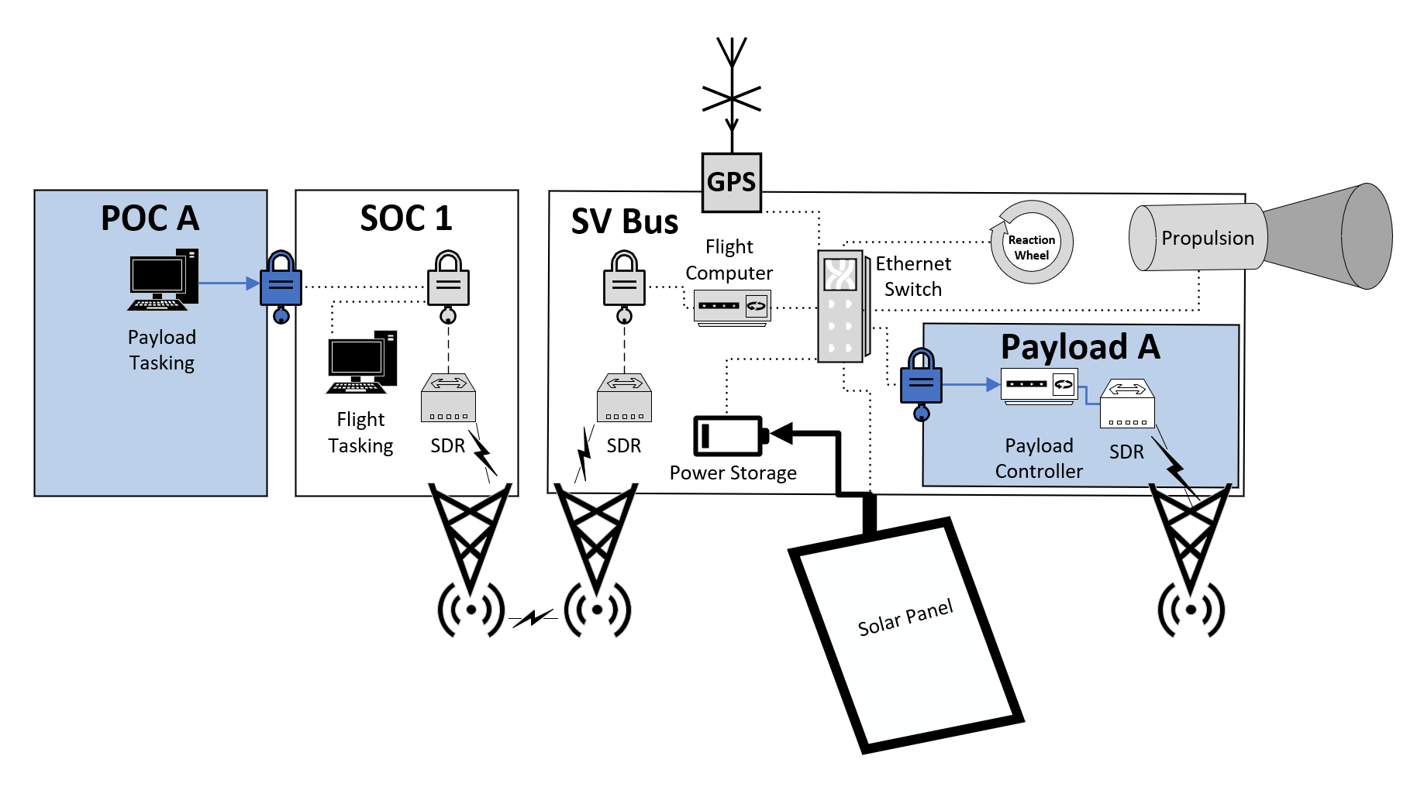
EARTH
SPACE
Notes:
Bus Vs. Payload

Slide 29
Notes:
Bus Vs. Payload

Slide 30
Notes:
Bus Vs. Payload

Slide 31
Notes:
Bus Vs. Payload

Slide 32
Notes:
Bus Vs. Payload

Slide 33
Notes:
Bus Vs. Payload

Slide 34
Notes:
Bus Vs. Payload

Slide 35
Notes:
Bus Vs. Payload

Slide 36
Notes:
Bus Vs. Payload

Slide 37
Notes:
Bus Vs. Payload

Slide 38
Notes:
Bus Vs. Payload

Slide 39
Notes:
Bus Vs. Payload

Slide 40
Notes:
Bus Vs. Payload

Slide 41
Notes:
Bus Vs. Payload

Slide 42
Components
Logic Bearing
SDRS
Flight computer
Encryption devices
‘Dumb’
Reaction Wheels
Propulsion
Antennae
Solar panels

Slide 43
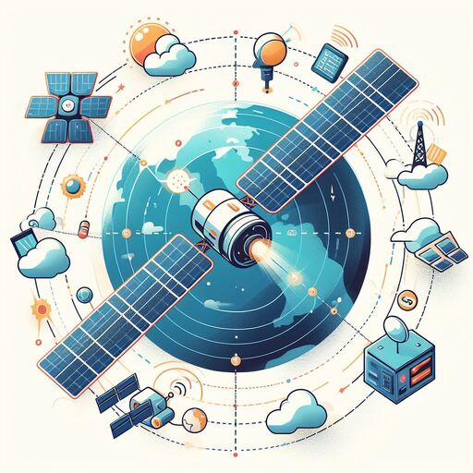
CONOPS

Slide 44
Notes:
Bus Vs. Payload

Slide 45
Notes:
Bus Vs. Payload

Slide 46
Notes:
Bus Vs. Payload

Slide 47
Notes:
Bus Vs. Payload

Slide 48
Notes:
Bus Vs. Payload

Slide 49
Notes:
Bus Vs. Payload

Slide 50
Notes:
Bus Vs. Payload

Slide 51
Notes:
Bus Vs. Payload

Slide 52
Notes:
Bus Vs. Payload

Slide 53
Notes:
Bus Vs. Payload

Slide 54
Notes:
Bus Vs. Payload

Slide 55

Space Is Like…Really Hard…

Slide 56
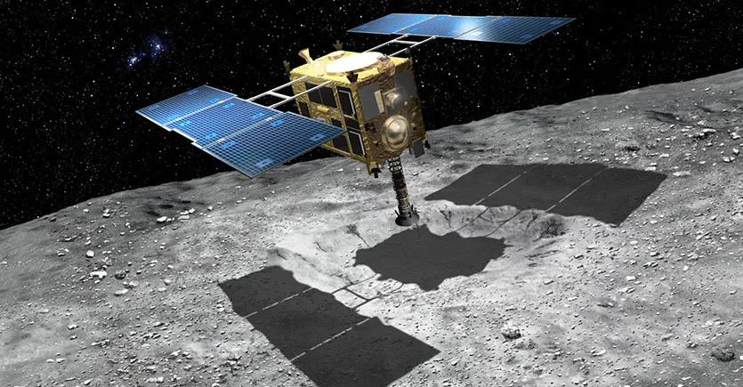
Hayabusa
May 9th, 2003, Japan launches the satellite that will eventually be renamed to Hayabusa with the intention of sampling surface material from a small asteroid and bringing it back to Earth. Something that had never been done before.

Slide 57
Hayabusa
In late 2003, a large solar flare significantly damaged its solar panels, delaying its intended 2005 arrival at the asteroid by several months.

Slide 58
Hayabusa
In July 2005 one of three reaction wheels (the x-axis controller) used to adjust the satellite’s attitude, fails.
In October 2005 another reaction wheel fails (the y-axis controller), forcing it to use the one remaining reaction wheel and some of its thrust to fly and steer.

Slide 59
Hayabusa
On November 12, 2005, the satellite’s small lander vehicle was launched at an incorrect altitude and flew off into space.
November 19, 2005, the satellite itself tried at landing on the asteroid, but bounced and lost contact. Eventually contact was restored and it left the asteroid surface after 30 minutes.

Slide 60
Hayabusa
November 25, 2005, the satellite made its second landing, attempting to fire its two sampling bullets, which both failed.
December 2005, a thruster leak alters the direction of the antennae and connection is lost for three months.
Use of Backup antenna results in 1000x slower communications, protocol re-engineering made bandwidth usable

Slide 61
Hayabusa
Hayabusa limped back to Earth with:
10-100x slower communications due to damaged primary antenna
No chemical fuel
A small portion of its solar panels powering a limited thrust ion thruster,
Only 1 out of 3 reaction wheels still functioning
4 of the 11 batteries on board not functioning.

